Slide 1
Sprint #1
By Team [Hip, Hip]: Jack, Alea, Davis, and Elizabeth

Slide 2
Overview
Client side requirement implementation
Front-end design planning
Front-end implementation
Process and code
Back-end database implementation
Process and code
We will be talking about…

Slide 3
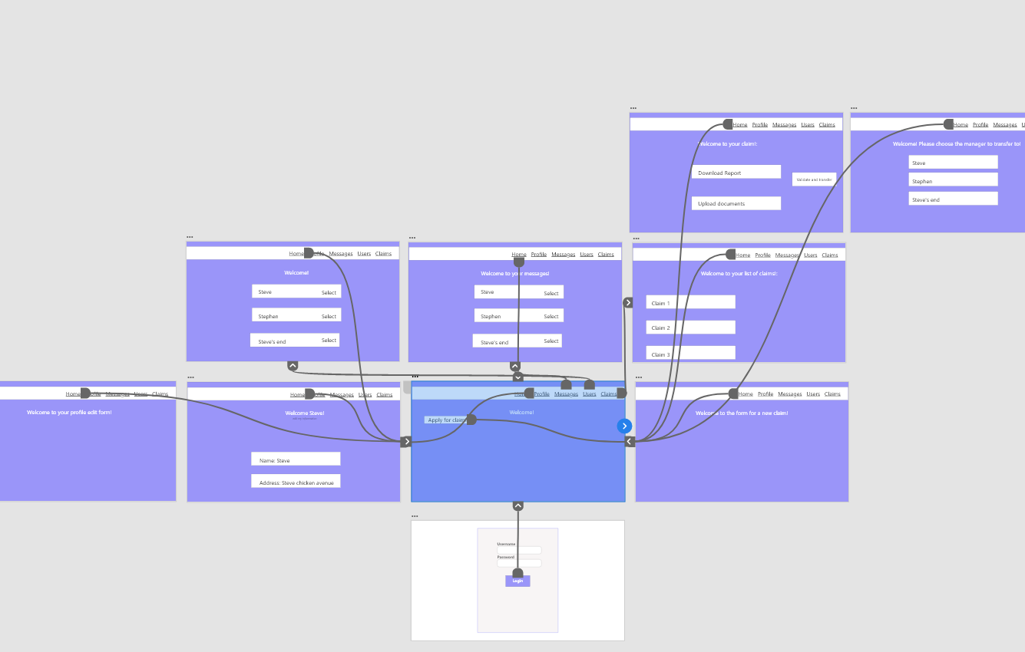
Adobe XD Framework

Slide 4
User Story Review - The Client Can…
Use unique credentials to log into the insurance claim management system (ICMS)
Apply for a claim
View their claims and claim status
Can download reports and upload scanned documents
View the messages sent to them from the…
Client Manager (CM), Finance Manager (FM), and Admin
Edit and view their profile details

Slide 5
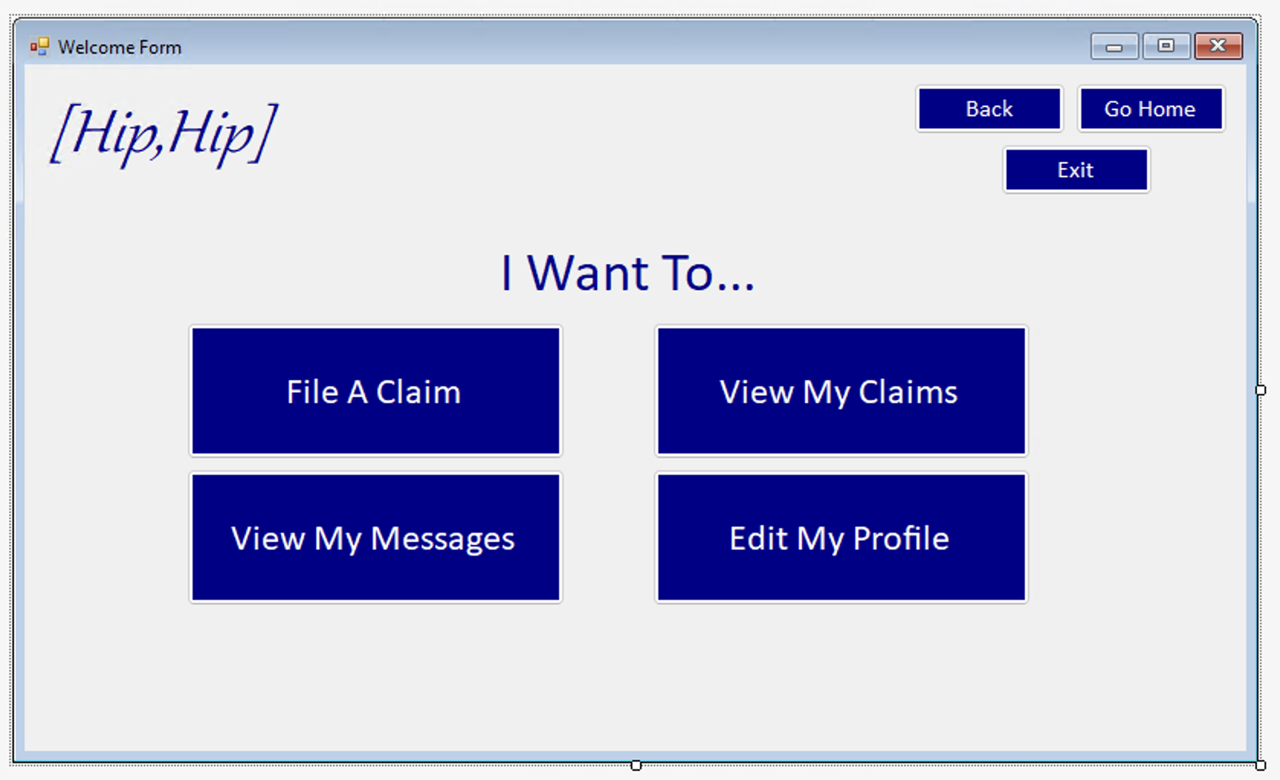
Front-end Planning & Design
Because this will be a public front end, we want to make it very intuitive.
Our homepage is designed to make it simple for the public user, with complications to be added for employees as needed

Slide 6
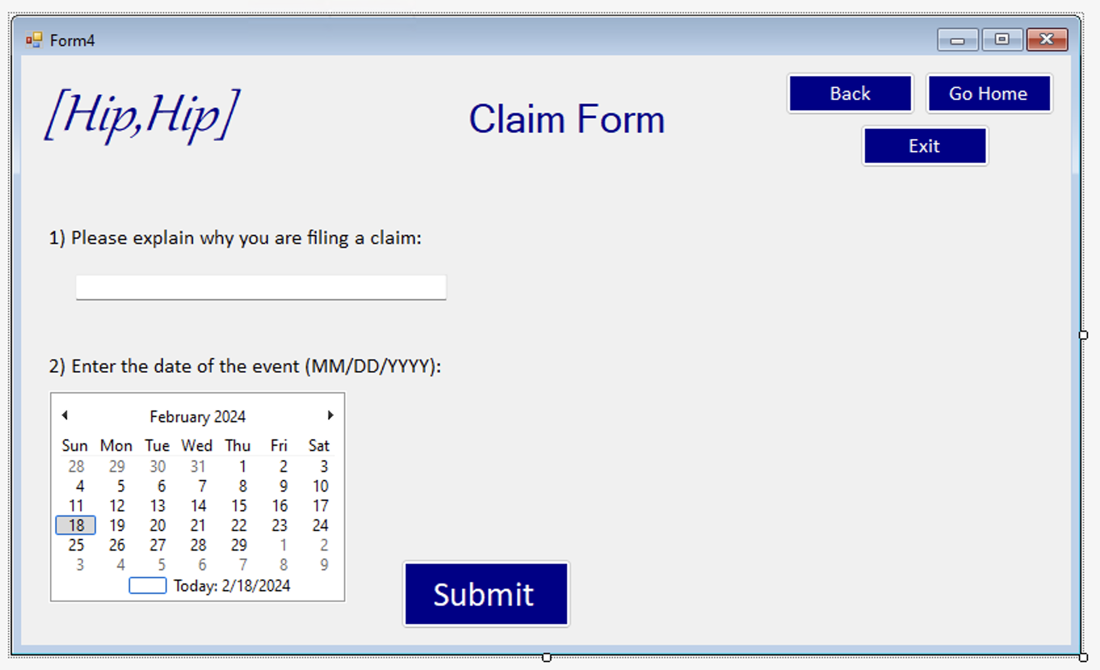
Front-end Planning & Design cont.
The user will fill out the basic info for the claim, which will generate a claim that is saved to the database

Slide 7
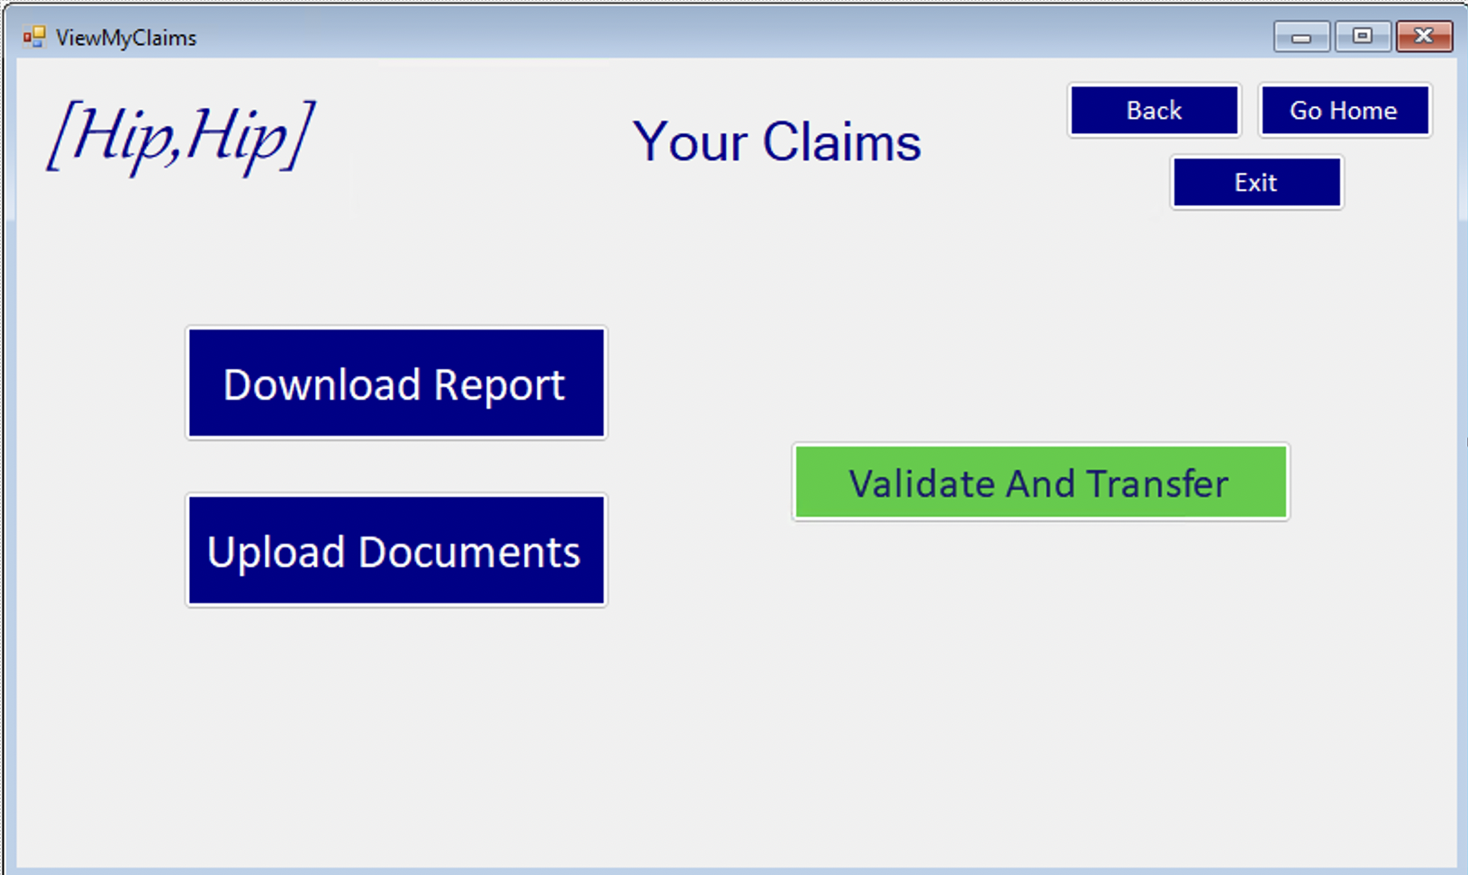
Front-end Planning & Design cont.
The client can also view the claims that they have filed as well as the status of their claims by downloading a report
Additionally, they're able to upload relevant documents, get them validated then transferred to the appropriate personnel

Slide 8
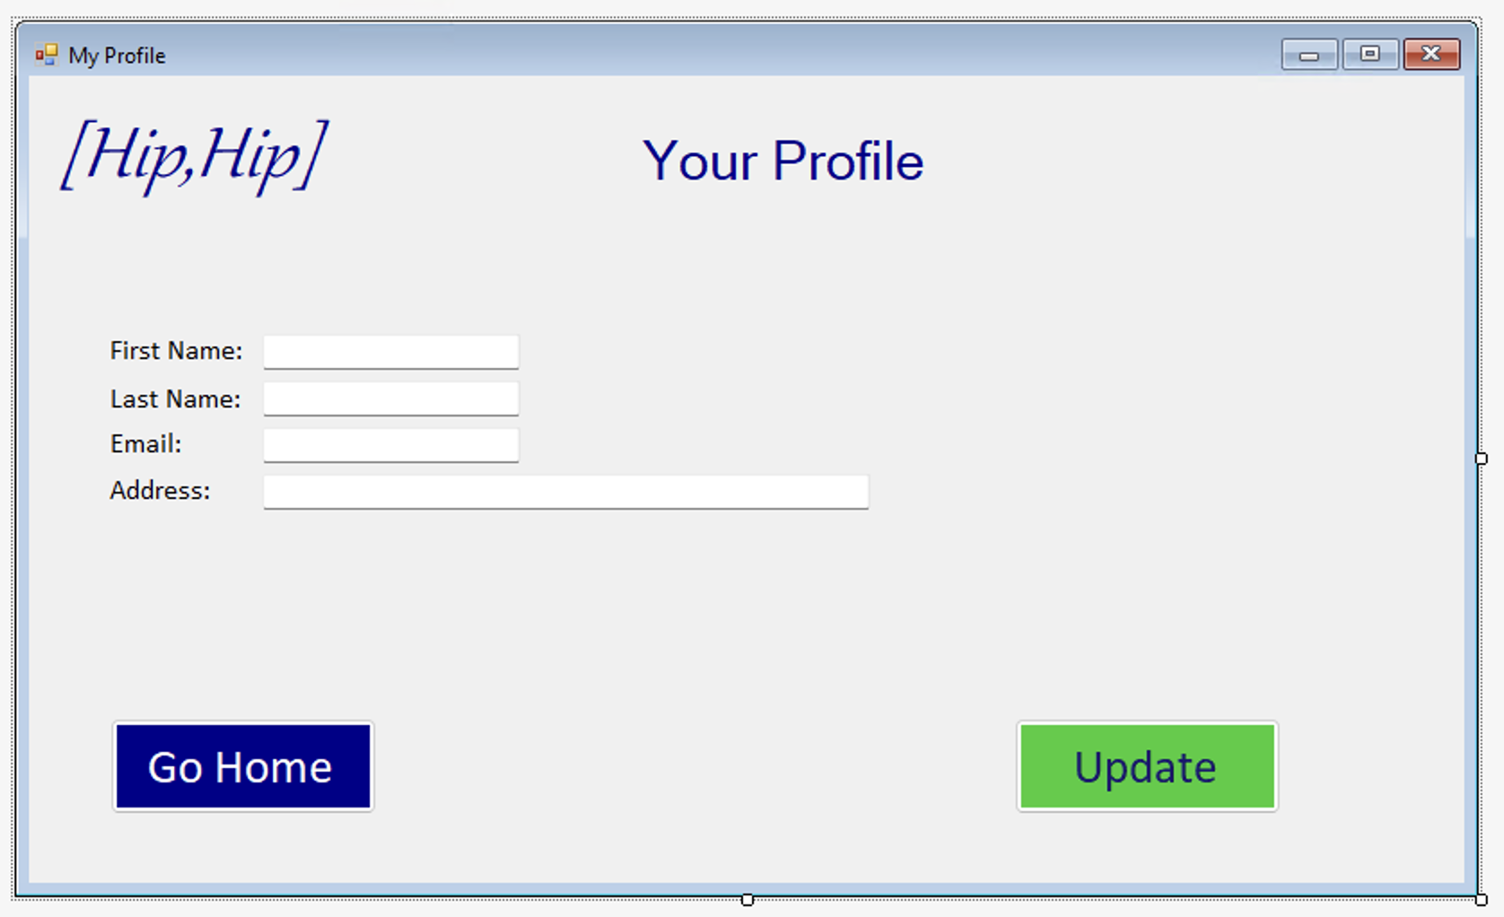
Front-end Implementation
Here the user will be able to update their profile information, which will be saved to the database

Slide 9
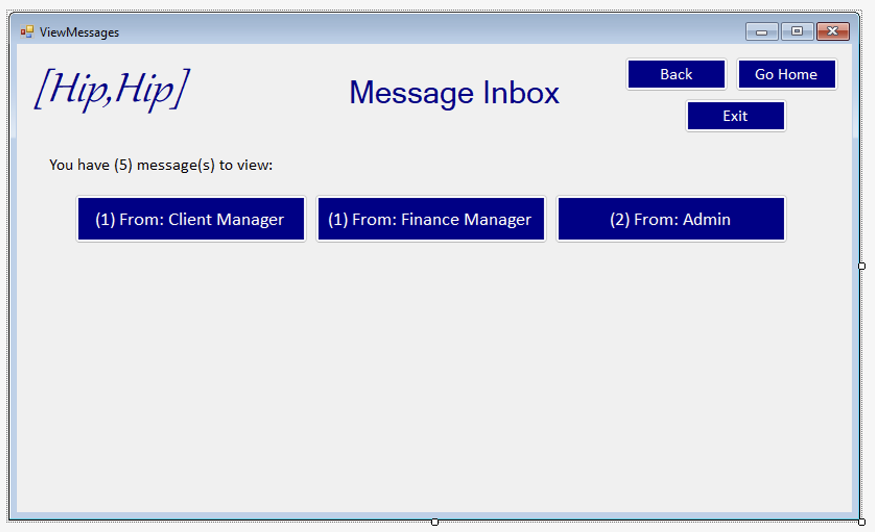
Front-end Implementation cont.
On the view messages form, the user will be able to view their general inbox status and can choose to look at the messages from either the Client Manager, Finance Manager, or Administrator

Slide 10
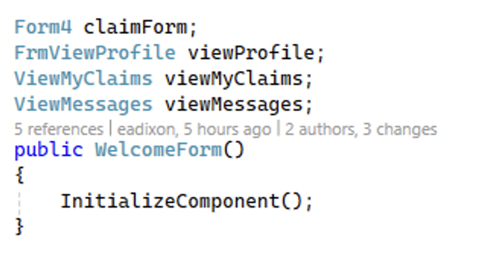
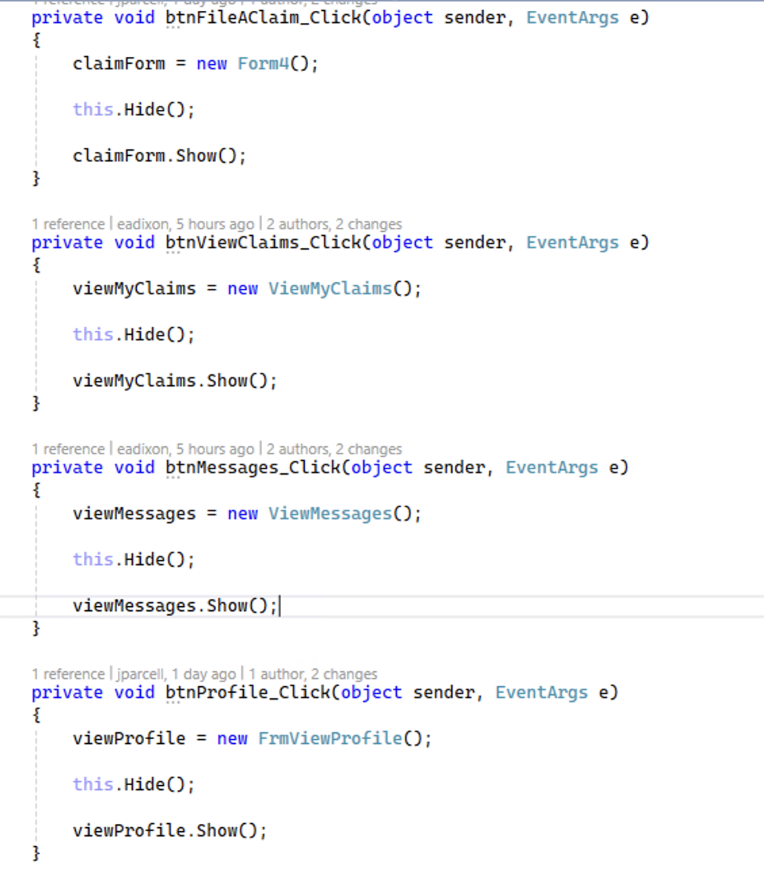
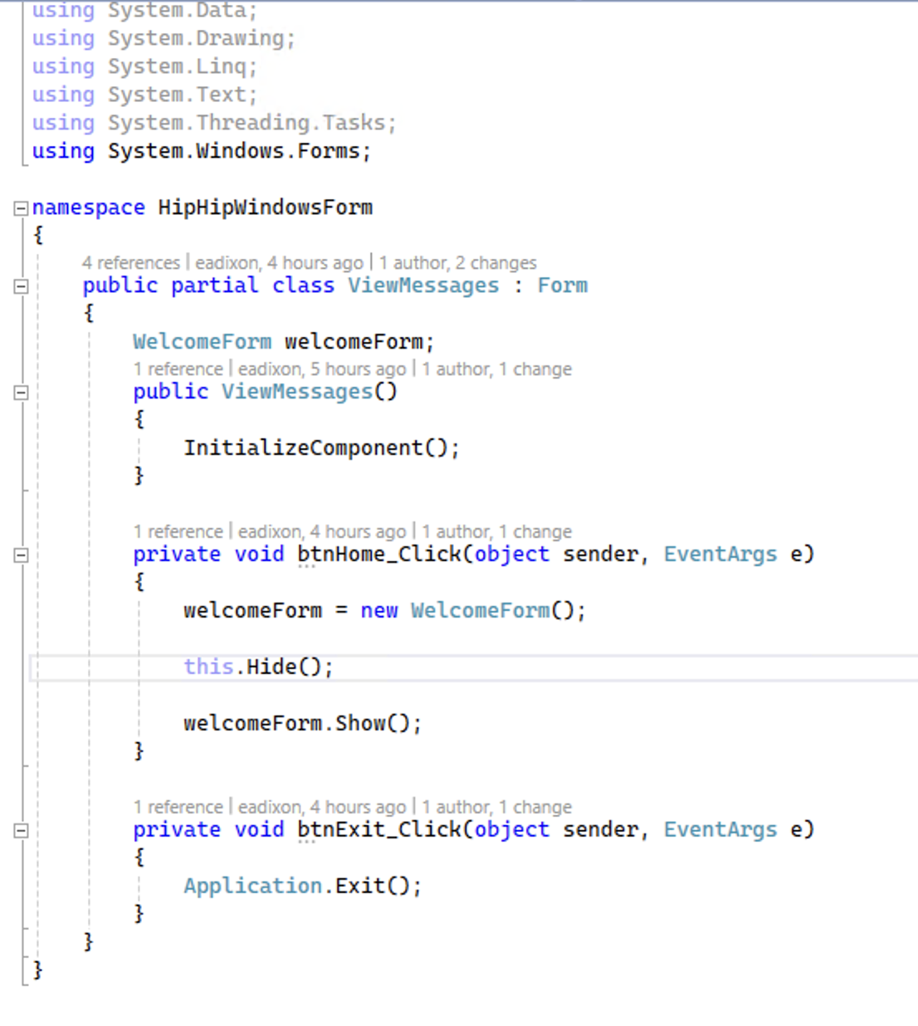
Front-end Code Examples
Initialization of "Form" partial classes to make correct transitions when buttons are hit
Form transition functionality (from homepage)
General button functionality code

Slide 11
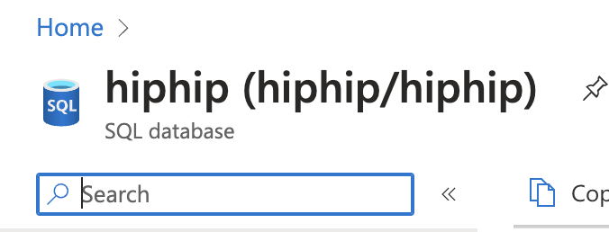
Back-end Database Implementation
We have set up an Azure SQL server
Successfully connected the database to the visual studio project

Slide 12
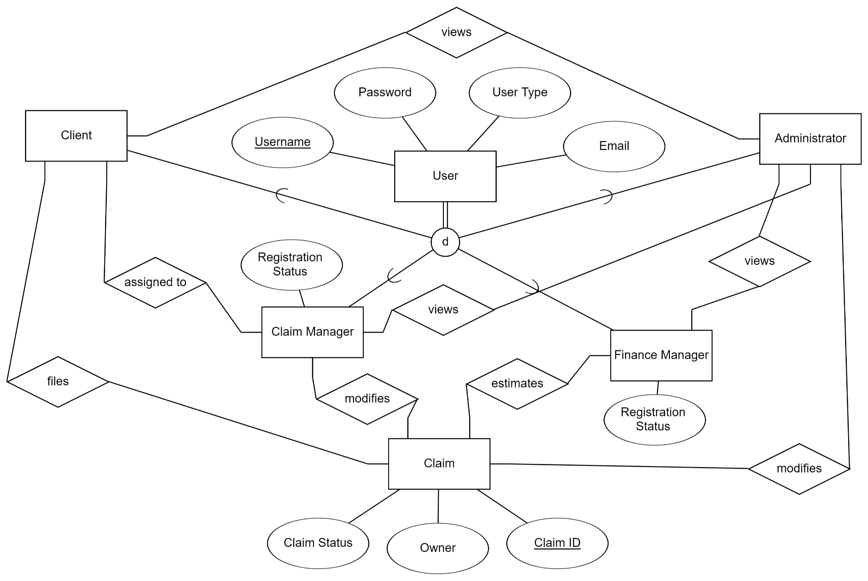
Back-end Database Implementation cont.
Work has begun on a rough draft of the ERD
ERD design is based off of the functional requirements and use case diagrams provided on Canvas
Potential future implementations:
specify types of relationships between entities (1:1, 1:many, many:many, etc.)
add in additional attributes to entities that may be unique to those entities (User entity already affects 4 sub-entities, but we have not yet discussed what attributes the sub-entities might have that the User entity does not cover)

Slide 13
Any Challenges?
Github syncing issues
Visual Studio workflow and error management

Slide 14

Client Demo

Slide 15
What's Next?
Set up User types and sample login
Start working on Messages functionality
i.e. subject line and message preview (like Outlook)
Start focusing on another user story
Client Manager, Financial Manager, or Administrator
Let "Go Home" message box function as a warning
Don't allow an immediate exit from the current form
See how the back button can be utilized

Slide 16
Any Questions?

